Slide 1
PRAGNYA COLLEGE OF MANAGEMNET & COMPUTER STUDIES
AUDITING & TAXATION

Slide 2
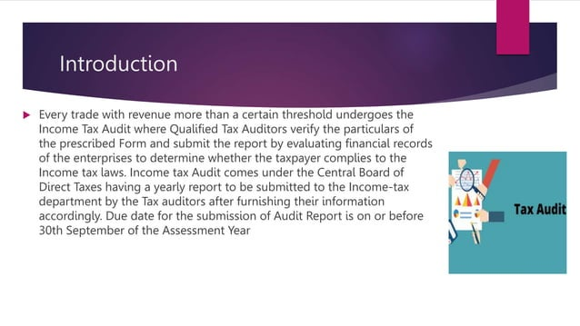

Slide 3
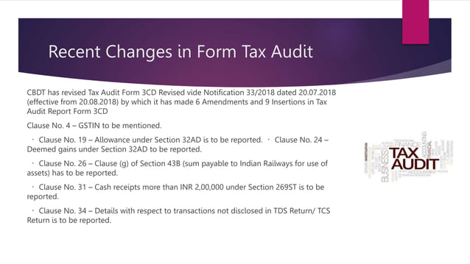

Slide 4
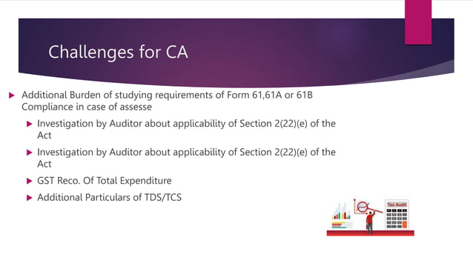

Slide 5
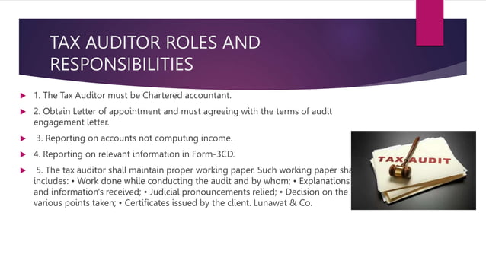

Slide 6
