Slide 1

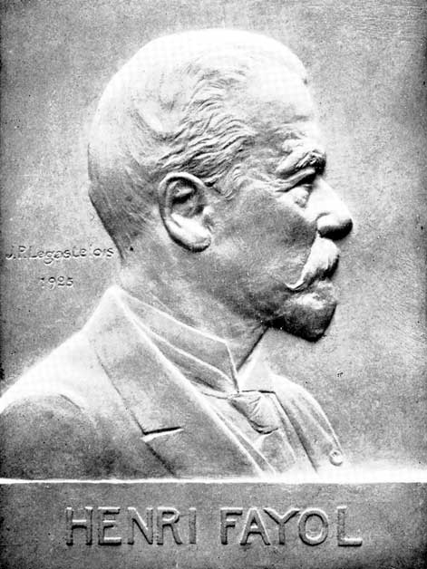
Seminar
On
Principles of Management
Notes:
1
1

Slide 2
CONTENT
Introduction
Division of Work
Authority and Responsibility
Discipline
Unity of Command
Unity of Direction
Subordination of Individual Interest Remuneration
The Degree of Centralization
Scalar Chain
Order
Equity
Stability of Tenure of Personnel
Initiative
Esprit de Corps
Conclusion

Slide 3
INTRODUCTION
In the last century, organizations already had to deal with management in practice. In the early 1900s, large organizations, such as production factories, had to be managed too.
At the time there were only few (external) management tools, models and methods available. Thanks to scientists like Henri Fayol (1841-1925) the first foundations were laid for modern scientific management.

Slide 4
These first concepts, also called principles are the underlying factors for successful management. Henri Fayol explored this comprehensively and, as a result, he synthesized the 14 principles of management.
Henri Fayol ‘s principles of management and research were published in the book ‘General and Industrial Management’ (1916).

Slide 5
1. DIVISION OF WORK:
Work should be divided among individuals and groups to ensure that effort and attention are focused on special portions of the task. Fayol presented work specialization as the best way to use the human resources of the organization.

Slide 6
2. AUTHORITY:
The concepts of Authority and responsibility are closely related. Authority was defined by Fayol as the right to give orders and the power to exact obedience. Responsibility involves being accountable, and is therefore naturally associated with authority. Whoever assumes authority also assumes responsibility.

Slide 7

3. DISCIPLINE:
A successful organization requires the common effort of workers. Penalties should be applied judiciously to encourage this common effort.

Slide 8

4. UNITY OF COMMAND
Workers should receive orders from only one manager.

Slide 9

5. UNITY OF DIRECTION:
The entire organization should be moving towards a common objective in a common direction.

Slide 10

6. SUBORDINATION OF INDIVIDUAL INTERESTS TO THE GENERAL INTERESTS
The interests of one person should not take priority over the interests of the organization as a whole.

Slide 11

7. REMUNERATION
Many variables, such as cost of living, supply of qualified personnel, general business conditions, and success of the business, should be considered in determining a worker’s rate of pay.

Slide 12
8. CENTRALIZATION:
Fayol defined centralization as lowering the importance of the subordinate role. Decentralization is increasing the importance. The degree to which centralization or decentralization should be adopted depends on the specific organization in which the manager is working.

Slide 13
9. SCALAR CHAIN:
Managers in hierarchies are part of a chain like authority scale. Each manager, from the first line supervisor to the president, possess certain amounts of authority. The President possesses the most authority; the first line supervisor the least. Lower level managers should always keep upper level managers informed of their work activities. The existence of a scalar chain and adherence to it are necessary if the organization is to be successful.

Slide 14
10. ORDER:
For the sake of efficiency and coordination, all materials and people related to a specific kind of work should be treated as equally as possible.

Slide 15

11. EQUITY:
All employees should be treated as equally as possible.

Slide 16
12. STABILITY OF TENURE OF PERSONNEL:
Retaining productive employees should always be a high priority of management. Recruitment and Selection Costs, as well as increased product-reject rates are usually associated with hiring new workers.

Slide 17
13. INITIATIVE
Management should take steps to encourage worker initiative, which is defined as new or additional work activity undertaken through self direction.

Slide 18
14. ESPIRIT DE CORPS:
Management should encourage harmony and general good feelings among employees.

Slide 19
THE IMPORTANCE OF THE PRINCIPLES
Having a clear management structure in place is vital for any successful organization. Efficient and well intentioned management sets the tone for the rest of the staff. It is common for the attitude approach of managers to filter through the entire organization, so having managers working in an exemplary way is an excellent example for employees to follow

Slide 20
CONCLUSION
The 14 principles of management can be used to manage organizations and are useful tools for forecasting, planning, process management, organization management, decision-making, coordination and control.
Although they are obvious, many of these matters are still used based on common sense in current management practices in organizations. It remains a practical list with focus areas that are based on Henri Fayol ’s research which still applies today due to a number of logical principles.

Slide 21
REFERENCE
www.google.com
www.wikipedia.com
www.studymafia.org

Slide 22
THANKS

